Slide 1
Melville’s Moby dick and Ellison’s Invisible man: two American microcosms

Slide 2
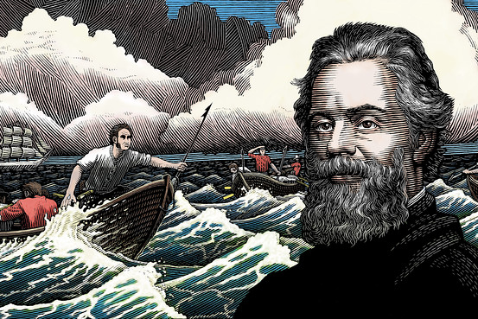
Herman Melville (1819-1891)
He was born in new york and spent many years at sea on whaling ships and in exotic lands.
His masterpiece is Moby dick
PLOT: The novel is narrated by Ishmael, the only survivor of Pequod’s crew, whose ship is commanded by Captain Ahab, who is literally obsessed by Moby Dick, a white whale that ate his leg.. After several adventures the man and the whale meet face to face and it is Moby Dick who wins, killing Captain Ahab with all his crew.

Slide 3
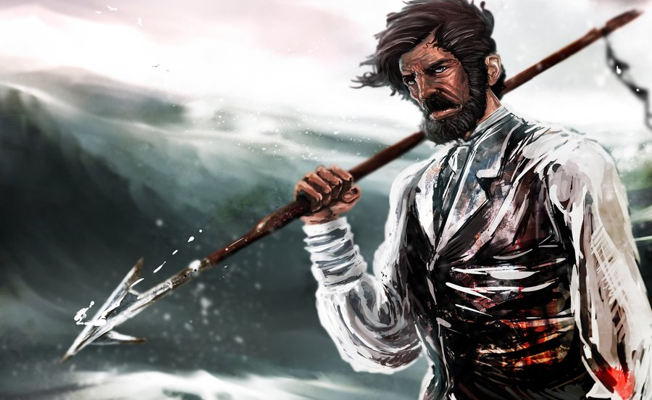
1.realism allegory;
2.based on a rich texture of biblical references;
3.it may be read at two levels:
-a great adventurous sea-story;
-a deeply symbolical work of art expressing its author’s philosophical and religious concerns;
5.a microcosm mirroring the crisis of the macrocosm. This microcosm contains men of all races and creeds, reflecting the composite texture of the newly-born American nation.
4.symbol of mankind fighting the presence of evil in the world;

Slide 4
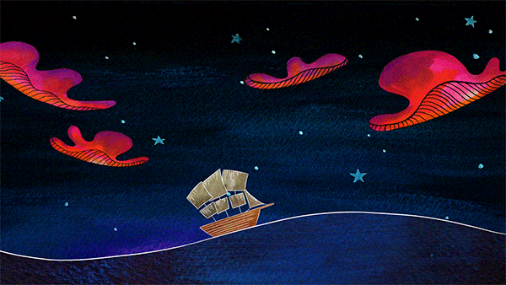
The Chase – Third Day: the Whale Kills the Man
● at the end of the novel.Ahab and Moby Dick face each other for the final fight. The Captain follows the whale to find the best position to throw the harpoons but the whale suddenly swims back towards the Pequod and makes a
breach through the bow: Ahab’s beloved Pequod begins to sink.
● Ahab’s final speech is clearly modelled on those of epic heroes and the final paragraph ends the story on a note of philosophical and religious meditation.
● vivid realism ( the sinking of the boat) + allegory (the reference to Fata Morgana)
-> through the foam and the sea turbulence the crew saw the side of the sinking ship, looking like a phantom- as in the mirage at sea known as Fata Morgana
‘’Towards thee I roll, thou all-destroying but unconquering whale; to the last I grapple with thee; from hell’s heart I stab at thee; for hate’s sake I spit my last breath at thee. Sink all coffins and all hearses to one common pool! and since neither can be mine, let me then tow to pieces, while still chasing thee, though tied to thee, thou damned whale! Thus, I give up the spear!’’

Slide 6
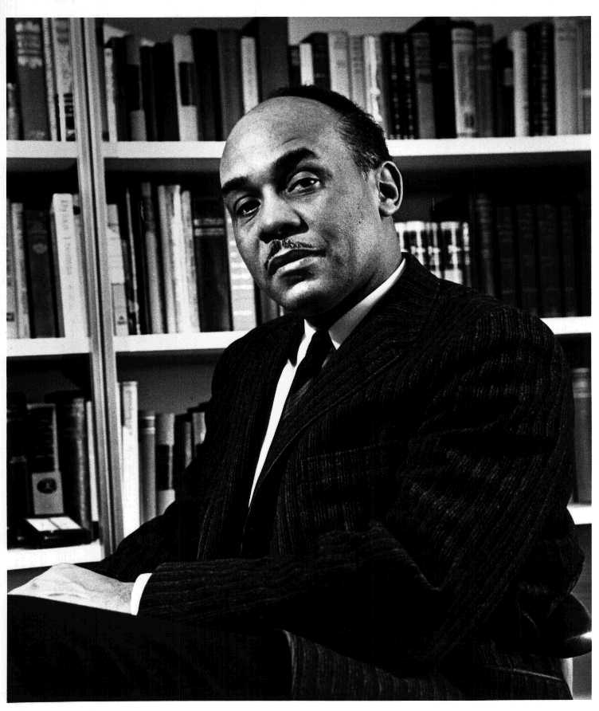
Ralph Ellison(1914-1994)
He left his studies in music composition at Tuskegee Institute in Alabama before taking his degree because of a precarious financial situation.
He moved to New York where he took up sculpture and indulged in literature as a hobby.
Invisible Man (1952): it’s his first novel, thanks to which Ellison won the National Book Award.
Even if he was appointed to many honorary positions he chose not to become a public
figure and insisted on the artist’s right to concern himself first of all with his art.

Slide 7
The invisible man (prologue)
THEMES:
‘’That invisibility to which I refer occurs because of a peculiar disposition of the eyes of those whit whom I come in contact. A matter of the construction of their inner eyes, those eyes with which they look through their physical eyes upon reality. ‘’
1)Light and darkness;
2) Invisibility: the name is never revealed;
3)Reference to Freud: the cellar where the hero lives may be regarded as a womb, the symbol of fertile retreat from which he will emerge, reborn from a womb;
4) Dream and unconscious;
5) Jazz and blues music, Louis Armstrong ;
Invisible Man PLOT: The nameless narrator is a black man who tries to find his identity in relation to white society. He lives in a forgotten basement in Harlem, illuminated by 1369 bulbs and he is draining off the power without paying for it. In this state of hibernation, the Invisible Man sets out to several episodes of his life up to the moment he looked for an underground refuge,and chose to remain there until he could emerge into real rather than artificial light.

Slide 8
Created by: Balsamo Arianna Guglielmino Paolo Licandri Lorenza Magrì Lorena Platania Christian Sinatra Alessandro Anno Scolastico 2016/2017 classe V sezB scientifico fonti: A. Cattaneo – D. De Flavis, Millenium, Signorelli M. Spiazzi-M. Tavelli, Lit&Lab, Zanichelli.

