Slide 1
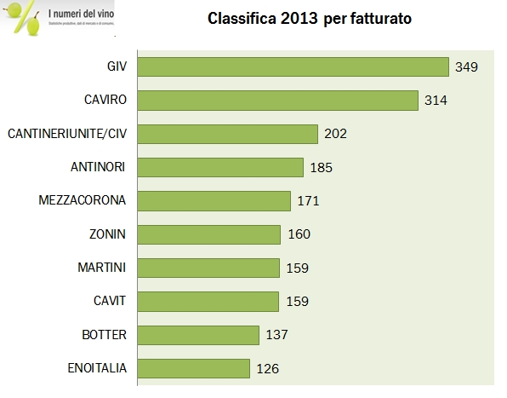
the Competition of start-up
The highest turnover
of a company is equal to sum of all sales revenues , services from a company ‘s sales in the tax year against invoices issued.
∑ Sales revenues
Paternò Italy, Meeting 19 – 23 March 2018

Slide 2
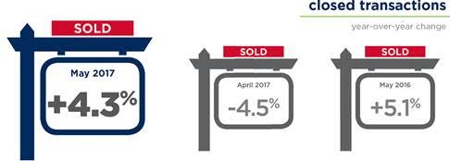
the Competition of start-up
The highest number of successful transactions
we mean the number of performances commercial contracts, as regards previous contact with buyers.
Successful contracts x 100
---------------------------------
the number of contacts
Paternò Italy, Meeting 19 – 23 March 2018

Slide 3
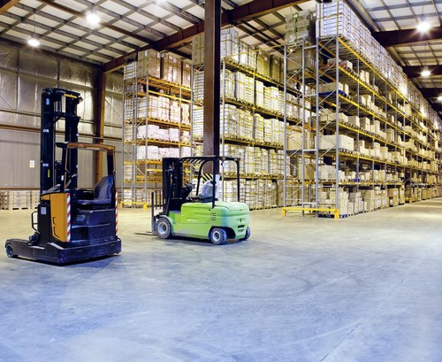
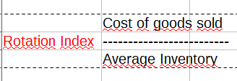
the Competition of start-up
Highest profit
The rotation index of a storehouse shows how a firm control how much it sells in a particular time. (1year, 2months, etc...)
Quick rotation of werehouse stocks is considered from the company as a positive indicator because it shows how quick they sell goods before stocks can be old or not good anymore.
Paternò Italy, Meeting 19 – 23 March 2018

Slide 4
the Competition of start-up
Eco-Oriented Firms
Paternò Italy, Meeting 19 – 23 March 2018

Slide 5
the Competition of start-up
Profit
is the result of a gain
P=R-C
P= Profit
R= Revenues
C= Costs of goods sold
Paternò Italy, Meeting 19 – 23 March 2018

Slide 6
the Competition of start-up
Advertising Approach
We can consider all Kind of advertising: billboards ,TV Channel, on web sites or on social media.
Paternò Italy, Meeting 19 – 23 March 2018

Slide 7
the Competition of start-up
Best Presentation of a good business plan
Paternò Italy, Meeting 19 – 23 March 2018

