Slide 1
Eco-friendly farm
No pollution

Slide 2
We have inherited an agricultural farm managed traditionally but it creates a lot pollution.
Non renewable energy (Could be used one time).
Use of pesticides (Air pollution, water, Soil and food).
Use of old machinery (Air pollution, soil and water).
Wastewater for irrigation.
Use of plastic for package.

Slide 3
Can we transform it in an eco friendly farm? Yes.
Renewable energy (Solar panel).
Usage of useful insects, that feed harmful insects, and practice natural manure.
Use of modern machinery get fed for biofuels.
Installation for wells and tubs to collect rainy water.
Use of recycled and recyclable material for package.
biodiversity conservation.

Slide 4
Solar panel hold back the solar rays and they transform them into energy which can be accumulated.
The most useful insects they are ladybirds, the “lonely”wasps that feed aphids.
Biofuels and fuel derived from biomass: Wheat, Corn, Chard, Sugar cane, Palm oil. It comes from a renewable resource.
To avoid wasting water, use tanks and/or wells to collect rainwater to be used for irrigation.
To replace plastic for packaging with recycled and recyclable paper, cardboard and glass.

Slide 5
Drones for soil monitoring to perform three-dimensional surveys of the territory by superimposing images containing the data necessary for performing surface calculations, for controlling the degree of soil moisture and for evaluating the ripeness of fruits for the harvest.
Electric cars to move inside the agricultural farm to avoid pollution due to fuel combustion.
Filters to drain water and to filter fumes so to remove polluting elements: chemical, organic and inorganic elements.
Conveyor roller , machines to check soil and water level for precise agriculture using robotics and software that, includes a database useful to improve production.
Compost as a result of the composition and humification of a mixture of organic materials.
Renewable energies are energy sources obtained from naturally replenished resources such as sunlight, wind, rain, geothermal heat.

Slide 6
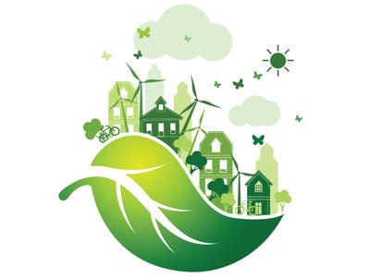
Logo della sostenibilità.

